Slide 1
Critical Appraisal of in Vitro Steady-State Frictional Resistance Studies
Samuel J. Burrow III
Seminar in orthodontic 2010; 16:244-248

Slide 2
Basic Mechanics
Engineering mechanics is the physical science that investigates motion and deformation of materialls under forces.
Models are simulated mathematically that can be used to make predicitons of the resulting motions of the physical model.
There is three type of models used

Slide 3
Basic Mechanics
Deformable continuous motion model
Is used to predict the flow field of a fluid
Not used in orthodontics

Slide 4
Basic Mechanics
Mass-point particle model
The element have mass but no volume
Balistic
Movement of an object in space

Slide 5
Basic Mechanics
Rigid-model
Assumes that no dimension of the body changes when it is loaded.
This is the model used in orthodontic model

Slide 6
Basic Mechanics
Mechanics is divided into two branches
Static and Dynamics

Slide 7
Basic Mechanics
Dynamics
Accelerated motion of the body
Divided into
1 Kinematic : study the geometry of motion
2 Kinetics : study force and mass in relation to kinematic

Slide 8
Basic Mechanics
Statics
Body at rest , unaccelerated motion
Under the influence of force
The system classically used in orthodontics model

Slide 9
Basic Mechanics Friction
Friction and resistance to sliding in orthodontics: A critical review
S. Jack Burrow
Am J Orthod Dentofacial Orthop 2009; 135: 442-7

Slide 10
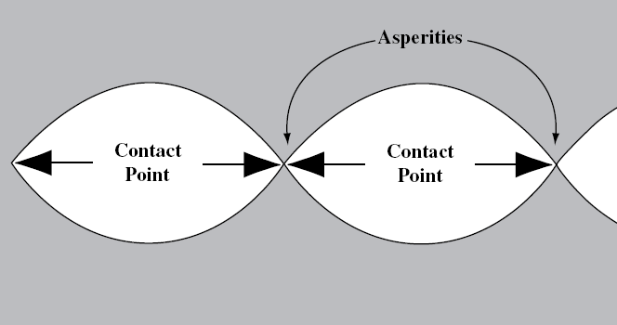
Basic Mechanics Friction
Friction is the resistive force between surfaces that oppose motion.
It is derived from electromagnetic forces between atoms
All surface are more or less irregular, friction is determined by the true contact area which is determined by asperitie.
As a consequence different material are going to behave differently
For the same material the characteristic of the surface will also have an influence.

Slide 11
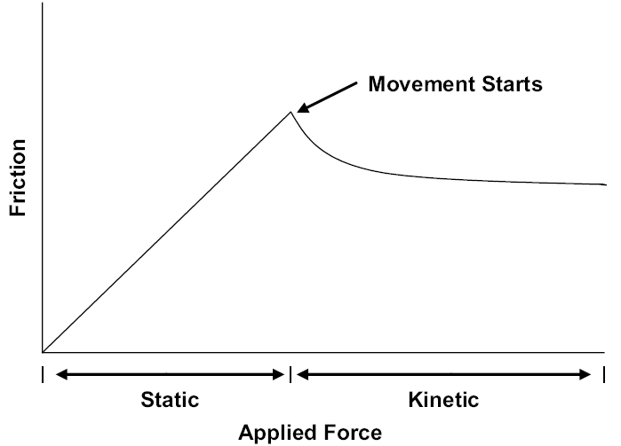
Basic Mechanics Friction
There are 2 type of friction.
Static friction, static friction opposes any applied force, it’s magnitude is exactly what it must be to prevent motion between 2 surfaces.
Kinetic friction, which usually is less than static friction then oppose the direction of motion of the object.

Slide 12
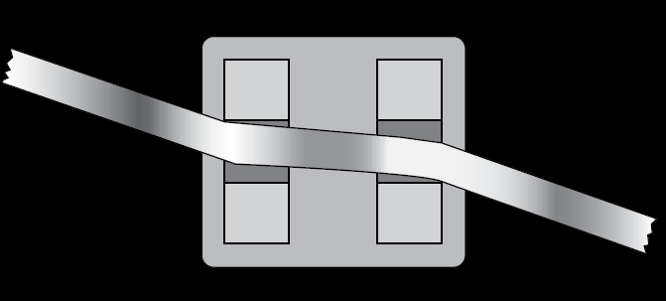
Basic Mechanics Friction
In orthodontic resistance to sliding as three components:
Friction static or kinetic due to contact of the wire with bracket surfaces.
This occur only if the wire is parallel to the slot

Slide 13
Basic Mechanics Friction
In orthodontic resistance to sliding as three components:
Binding : when the wire contact the angle of the bracket
the deformation of the wire is elastic and give rise to a moment.
In clinic: the tooth tip, binding is created, friction became negligible in relation to binding. Creation of a moment that oppose tipping of the crown

Slide 14
Basic Mechanics Friction
In orthodontic resistance to sliding as three components:
Notching: When the angulation of the wire increase, there is a plastic deformation of the wire.
When this happen the value of the resistance to sliding is determine by notching,
Friction and binding become negligible.

Slide 15
In vitro Steady friction Studies
Here Steady do not mean static but only that not attempt had been made to mimic the extra dental force.
Only the intron testing machine make the wire move.
The author give example of three kind of friction test which are quite representative of what can be found in the literature today.

Slide 16
First kind of study
Friction of Conventional and Self-Ligating Brackets Using a 10 Bracket Model
Simona Tecco; Felice Festa; Sergio Caputi; Tonino Traini; Donato Di Iorio; Michel D’Attilio
Angle Orthod 2005; 75: 1041-1045

Slide 17
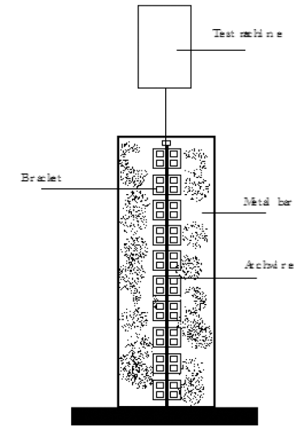
First kind of study
One of the most basic kind of test.
Use a cantilever configuration
10 brackets
Why 10 ?
Self-ligating bracket ‘avoid to do extraction’ so you need to put bracket from 5 to 5

Slide 18
First kind of study
With this kind of study you can investigate only friction.
Bending and Notching can not be investigated.
Trouble is friction become negligible when binding occur
Binding become negligible notching occur
Not very reproducible for investing the friction in a clinical situation.

Slide 19
Second kind of study
Frictional Evaluation of Dental Typodont Models Using Four Self-Ligating Designs and a Conventional Design
Sandra P. Henao, BS; Robert P. Kusy, BS, MS, PhD
Angle Orthod 2004; 75: 75-85

Slide 20
Second kind of study
The principle is basically the same, but instead of putting the bracket in line, a Typondont with a simulated malocclusion is used
4 kinds of self ligating bracket were used, and one kind of conventional bracket.
For each self ligating bracket the manufacturer give a list of Three wire to be used for each stage of the treatment.
Each of the three wire was inserted successively in each quadrant to test the resistance to sliding.

Slide 21
Second kind of study
One problem was that the typodont was used only for conducting the mechanical test.
The position of the teeth did not change between each wire
Consequently it was not possible to insert the third wire in all bracket and even one of the second wire.
Also the wire tested were not the same with each brackets.

Slide 22
Second kind of study
In theory the three component of the resistance to sliding were present: friction, binding and notching.
But it was not possible to quantify the part of each of them.
Also what was the value of using a wire design for the movement phase in an initial crowding configuration, this kind of situation are not encounter in clinic.

Slide 23
Third kind of study
Comparison of resistance to sliding between different self-ligating brackets with second-order angulation in the dry and saliva states
Glenys A. Thorstenson, BS, and Robert P, Kusy, BS, MS, PhD
Am J Orthod Dentofacial Orthop 2002; 121: 472-82

Slide 24
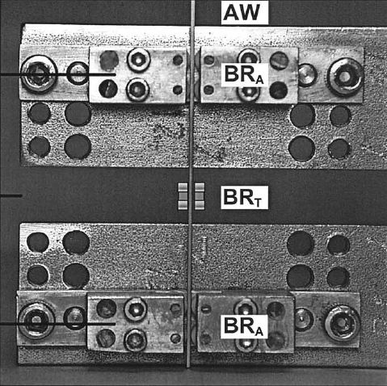
Third kind of study
The apparatus in this study was design to study the effect of second order bend.
Only self ligating bracket were tested, active one and passive one.
The effect of saliva was also tested
Friction and bending were observed

Slide 25
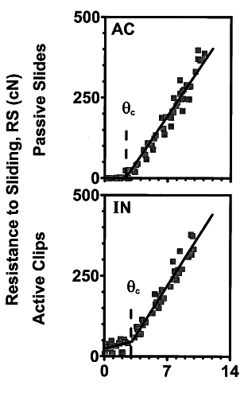
Third kind of study
The results show that there was some difference in friction between the active and passive self ligating bracket.
But this difference became insignificant as soon as bending began to occur

Slide 26
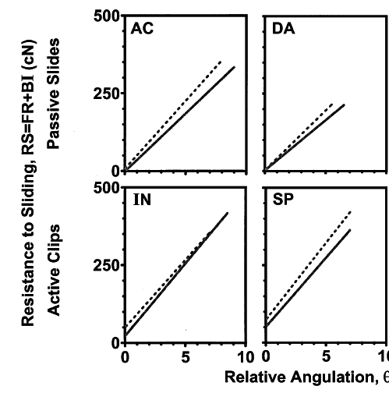
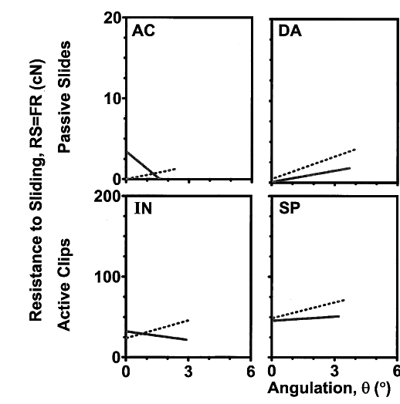
Third kind of study
Experiment also show that the saliva increase a little the resistance to sliding.
Conclusion, an experiment that does not include variation of angulation between the wire and the bracket is complement irrelevant.
But this experiment has been interpreted by some as showing that active clip generate more friction than passive one.
Passive clip make the teeth move faster.

Slide 27
History
Optimal force, differential force and anchorage
E.H. Hixon, H.Atikian, G.E. Callow, H.W. McDonald and R.J. Tacy
AJO volume 55, Number 1, May 1969 437-457

Slide 28
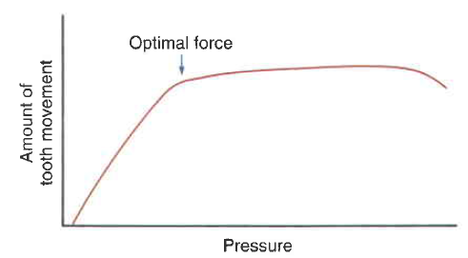
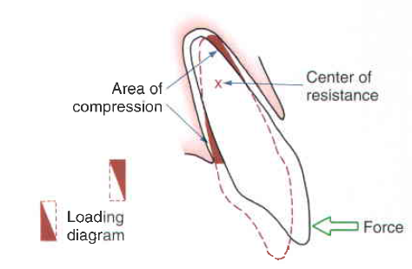
rational
The aim of this publication was to test the existence of an optimal force for tooth movement, and therefore the use of differential forces to improve anchorage
To test this hypothesis the effect of force on tooth movement had to be studied
Tipping movement produce an uneven pattern of stress on the tooth. The effect of force cannot therefore be studied
To study the effect of force, translation movement must be obtain, and the surface of the root must be estimated.
The force system must also deliver constant, and precisely measurable force.

Slide 29
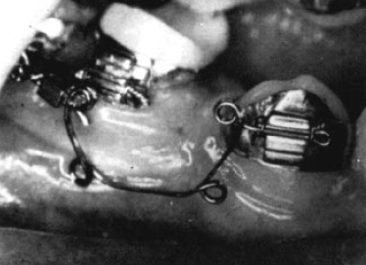
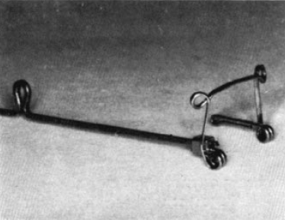
Rational
Segmented arch mechanic allow to control precisely the level and direction of force. The force delivered are also relatively constant.
The trouble was to obtain translation. During the retraction phase of the canine.
In the SAT the tipping is control by anti rotation bend, but the tipping is only limited not eliminated.

Slide 30
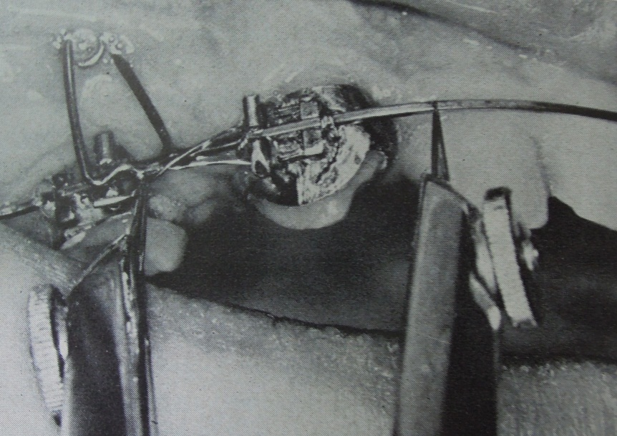
Basic Mechanics
After experimentation it was evident that eliminating the tipping movement was not possible by using SAT.
The solution was to use a continuous archwire as a guide for the sliding. The author used a 0.022×0.025 stainless steel wire

Slide 31
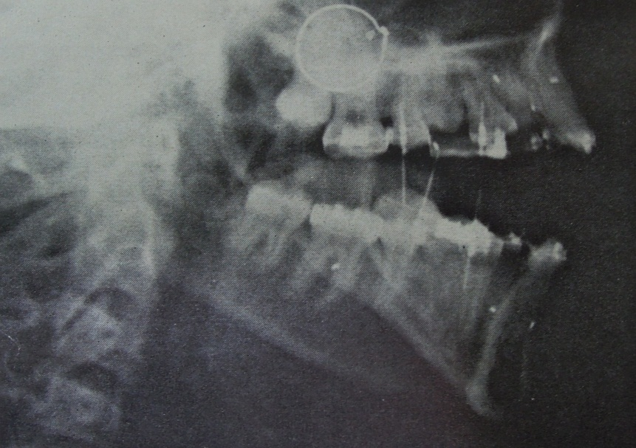
Basic Mechanics
The wire was soldered to the retraction spring.
To evaluate the displacement, titanium implant were used.
Scratch were made on the wire between each appointment.
Rotation and tipping occur.

Slide 32
History
On force and tooth movement
E.H. Hixon, T.O. Aasen, J. Arango, R.A. Clark, R. Klosterman, S.S. Miller, W.M. Odom
AJO volume 57, Number 5 1970 P 476-489

Slide 33
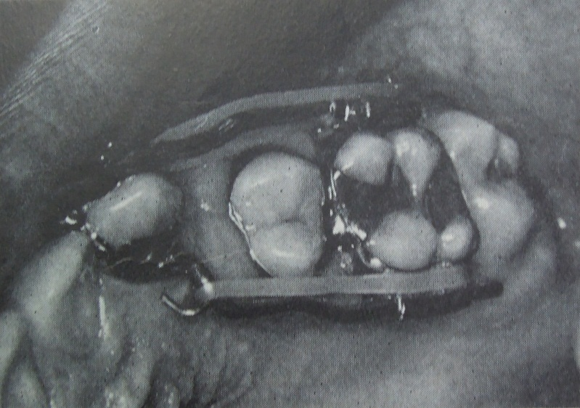
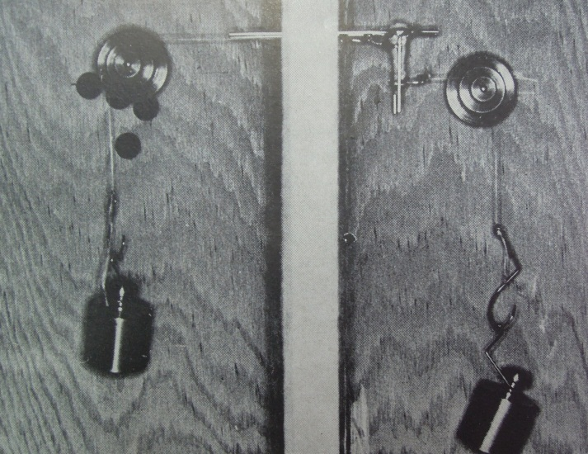
Basic Mechanics
To limit the tipping the author did the same experiment but this time by using a sliding mechanic with two wire (0.045 SS) for guide.
This way rotation was eliminated
The wires were inserted into tube
The force was delivered by using elastic.
The author as to estimate, the friction generated by the wire, the deflection of the wire, and de decay of the elastic.
The appliance was testing only one tube with no angulation between the tube and the wire. The configuration was cantilever like.
Of interest here are :
FRICTION and DEFLECTION

Slide 34
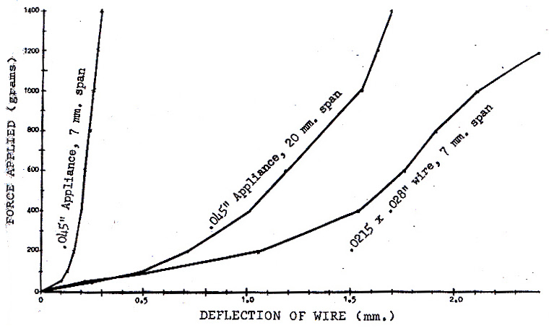
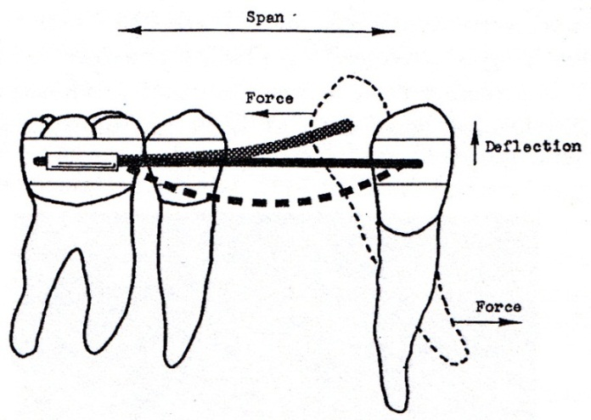
Deflection
Mechanical test show that in all case deflection of the wire would happen with the force used in the mouth event with the 0.045 wire.
The show that with orthodontic wire the movement obtain are not translation but a serie of tipping

Slide 35
Deflection
Tipping of the crown producing a deflection of the wire until the deflection of the wire counterbalance the retraction force.
The bending of the wire produce a tipping of the root.
Because of this basic mechanic the important factor during tooth movement will be binding not friction

Slide 36
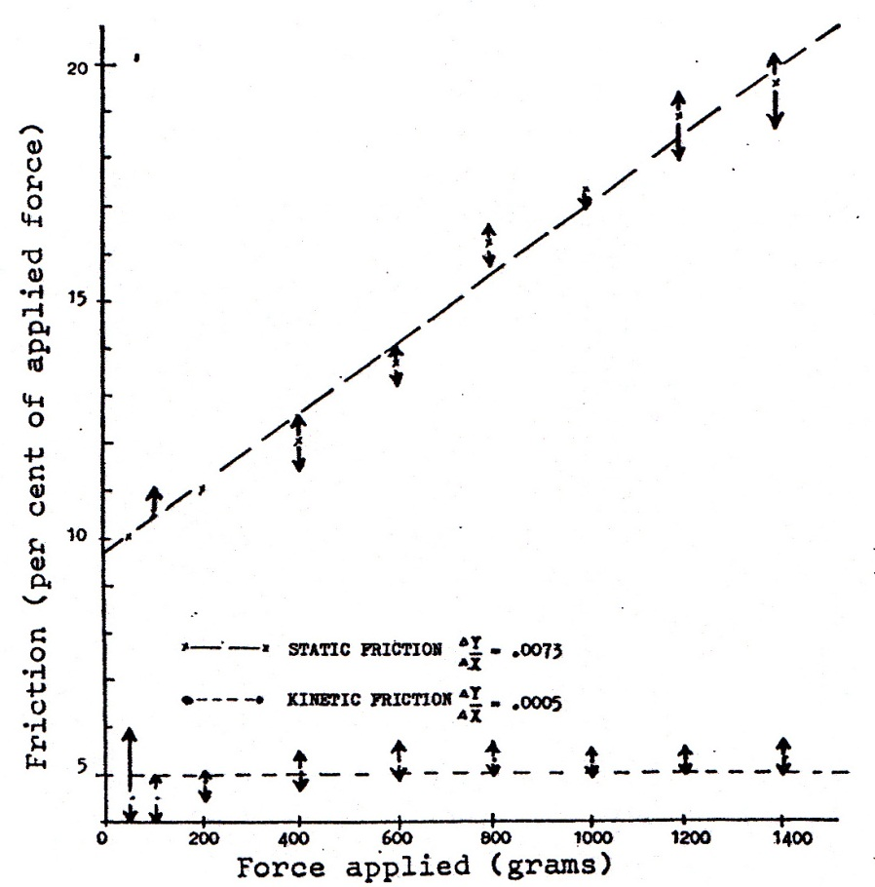
Conclusion
The friction was evaluated in with an intron machine.
The experiment showed that the part of the friction increase with the force applied. It range from 10 to 20% of the force applied
To stimulate the movement that can occur during mastication the experiment was repeated while using an electrical vibrator.
The friction level then dropped to 5% and stay almost constant independently of the force apply.
But this study used tube, not bracket with an active retention system (ligature or elastomeric chain)
Nevertheless it was the first to show that friction was influence by lateral movement of the wire in relation to the bracket.
It also show that tooth movement was a serie of tipping not a translation

Slide 37
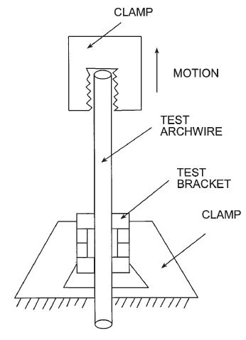
Vibration recent study 1
Other study have shown the inequacy of using a cantaliver configuration
Cantaliver configuration will understimate by a factor 3 to 9 the moment created by the bending force
Also the average distance of the center of rotation to the bracket slot is estimated at 10 mm

Slide 38
Vibration recent study 1
Friction in perspective
Stanley Braun, DDS, MME, Maurice Bluestein, PhD, B.Keith Moore, Phd, and Gary
Am J Orthod Dentofacial Orthop 1999; 115: 619-27

Slide 39
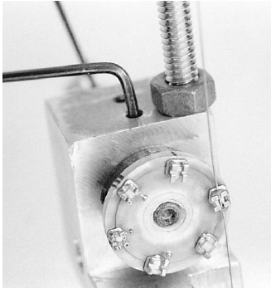
Vibration recent study 1
The appartus used allow to have two points of attachement
Two kind of bracket configuration were tested
Three size of wire
Two kind of ligation: elatomeric and ligature wire
Vibration were obtain by touche of the finger

Slide 40
Vibration recent study 1
The resulte show that the friction was reduce to zero at each vibration.
The resulte were not dependent of the type of ligation, the size of the archwire and the dimension of the bracket slot
The residual friction was more important with the 0.016 SS archwire than with the bigger diameter.

Slide 41
Vibration recent study 2
An Ex Vivo Investigation into the Effect of Bracket Displacement on the Resistance to Sliding
D. O’Reilly, B. Dent.SC., F.D.S., M.Dent.SC., M.Orth. P.A. Dowling, B.Dent.SC., F.F.D., D.Orth., M.Dent.SC. , M.Orth.
Bristish Journal of Orthodontics/ Vol. 26/1999/219-227

Slide 42
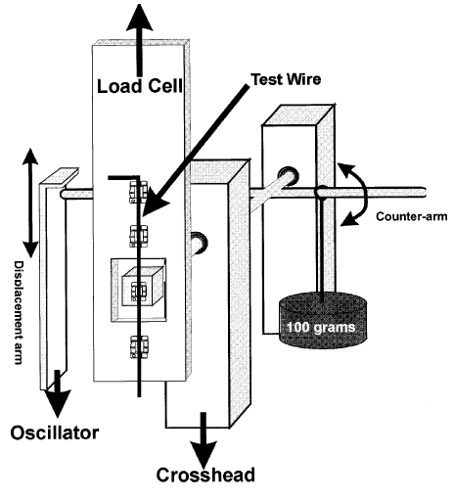
Vibration recent study 2
Same kind of appartus, two points of fixation for the wire, angulation of the bracket was variable.
The bracket used were of classic designe, but a piece of stainless steel wire was welded over each type of wing, to avoid the variable of ligation
In fact the bracket were equivalente to sefl ligating passive bracket.
In this experiment the experiment was done four time with different amplitude of displacement

Slide 43
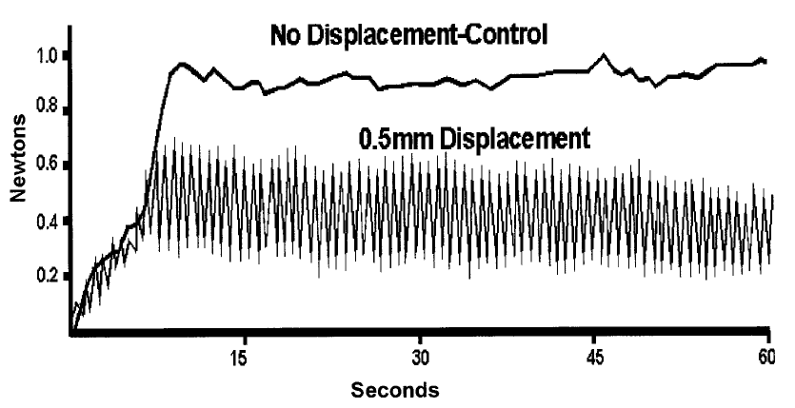
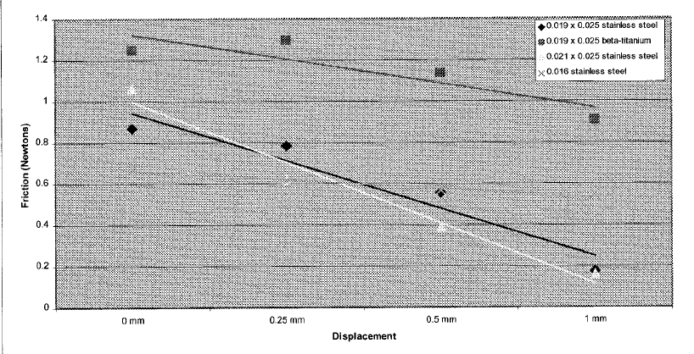
Vibration recent study 2
Typical graph
The red point show the maximum resistance (angulation of the bracket 0)
The blue point show the minimum restistance (maximum angulation of the bracket)
For the analysis only the points of maximum resistance were analysed.
They show a reduction of friction from 20% to 80% depending of the wire size.
They also show that the friction was more important for the 0.016 SS archwire than for the bigger diameter

Slide 44
Vibration recent study 3 In vivo
Clinical ligation forces and intraoral friction during sliding on a stainless steel archwire.
Laura.R. Iwasaki, DDS, MSc, PhD, Mark W. Beatty, DDS, MSE, MS, C. Jared Randall, DDS, MS, and Jeffrey C. Nickel, DMD, MSc, PhD
Am J Orthod Dentofacial Orthop 2003, 123:408-15

Slide 45
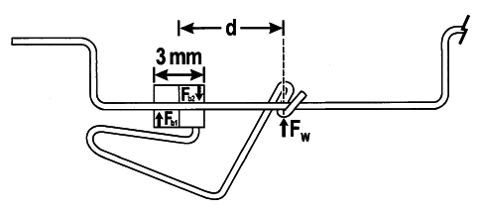
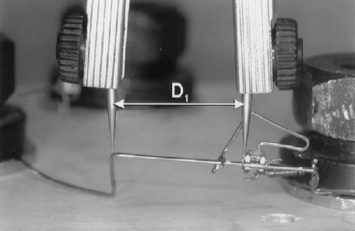
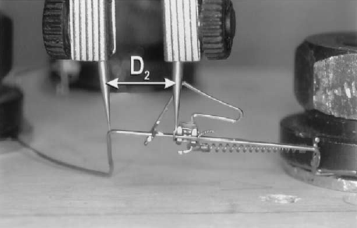
Vibration recent study 3 In vivo
One attempt was made at studying the effect of vibration in vivo.
This apparatus was used
The arms will assure the creation of a constant moment during the experiment.
In this experiment binding will be studied.

Slide 46
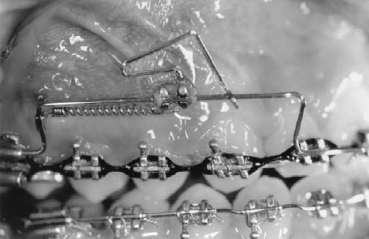
Vibration recent study 3 In vivo
The appliance was tested in the intra-oral environment and in the laboratory
The patient where ask to chew chewing gum during the experiment .
Elastomeric ligature, loose and thigh ligature were tested

Slide 47
Vibration recent study 3 In vivo result
Results
Impact of the kind of ligation ?
Impact of the vibration forces ?
What if the author had tested self ligation bracket?
Type of ligation had a significant impact on the displacement of the bracket
Vibration force made no difference to the displacement of the bracket
Probably no differences with a normal bracket
WHY?

Slide 48
Vibration recent study 3 In vivo result
In fact your are performing this kind of experiment but with only one value for the angulation of the bracket and the wire.
Your are performing it in the buccal environnement and in the lab

Slide 49
Vibration recent study 3 In vivo result
Because of the distance between the teeth the deformation of the wire was strongly reduce

Slide 50
Vibration recent study 3 In vivo result
More importantly only the orientation of the wire was changing.
The angulation of the bracket with the wire was constant, there was no release of the binding force as the previous experiment with vibration

Slide 51
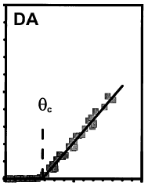
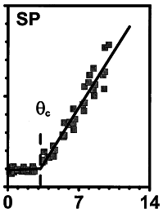
Vibration recent study 3 In vivo result
Consequently this experiment was not studying friction
but binding.
The type of ligation had an impact of the binding force
The more tight the ligation the more the binding force was increase.
This experiment is not comparable to the other vibration study

Slide 52
Clinical tooth movement in vivo study
As seen previously there is numerous way to make in vitro experiment and the result vary with the protocol.
But the important point is what happen in vivo with real patient

Slide 53
Study of tooth movement in segmental mechanic
Why in segmental mechanic ?
In segmental mechanic there is no friction, the force delivered is the force measured

Slide 54
SAT study Rational
The question at the time were :
was there an optimal force for moving teeth
Light force were they more physiologic than heavy one
SAT was used as it allow perfect measurement of the force delivered
Any disadvantage?
Prone to deformation during mastication which lead to unwanted tooth movement

Slide 55
SAT study Results
No variation was show the rate of tooth movement were virtually identical once a certain minimum force was obtain (around 60g) the result did not change event when force as heavy as 1500g were used.
The rate were around 1 to 1.3 mm/month
Once the minimum force level is reached biological phenomenon are the limiting factor.

Slide 56
Sliding mechanic studie
Comparative study repeatedly failed to show any difference in the tooth movement rate when using :
Different level of force
Different kind of brackets
Different configuration of archwire.
In all case the rate of tooth movement was around 1 mm/month.

Slide 57
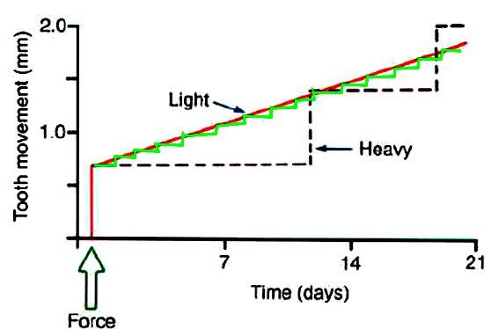
Conclusion
The in vitro test are fundamentally wrong, and are more the results of a marketing effort
The limiting factor of teeth movement is biological not mechanic

Slide 58
Thank you

Slide 59
Basic Mechanics

