Slide 1
Notes:
(fix font)
(no contractraction)

Slide 2
Allocating Security Analysts to Cyber Alerts Using Markov Games
Noah Dunstatter
Joint work with: Dr. Mina Guirguis, Alireza Tahsini
Notes:
Hello everyone! My name is Noah Dunstatter and today I’ll be presenting my paper “Allocating security analysts to cyber alerts using markov games”. And this was a joint work with my amazing advisor Dr. Mina Guirguis and my good friend and lab-mate Mr. Alireza Tahsini

Slide 3
|
OUTLINE
Motivation
Problem Statement
Related Works
Contributions
Markov Game Model
Game Theory 101
Value Iteration
Results
Conclusion
Notes:
So a quick outline, first I’ll attempt to motivate the work and give a taste of whats already been done and how our work differes from that. Then I’ll give you guys a quick description of our model and solution method, followed by our results.

Slide 4
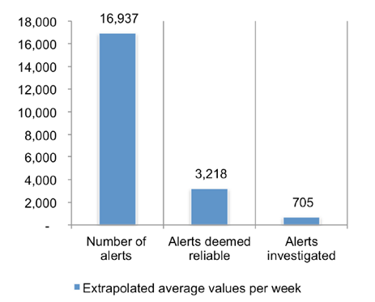
|
MOTIVATION
Cyber theft is the fastest growing crime in the U.S. and cost the global economy more than $450 billion in 2016 [Hiscox Cyber Readiness Report, 2017]
On average, organizations receive 17,000 malware alerts in a typical week, with only 700 (4%) being investigated [Ponemon Institute, 2015]
Security teams estimate that only about 19% of these alerts are reliable [Ponemon Institute, 2015]
Security teams waste an estimated 400 hrs/week chasing false positives [Ponemon Institute, 2015]
Notes:
So ok, as I’m sure you all know, cyber theft is the fastest growing crime in the U.S. and cost the global economy more than $450 billion dollars in 2016. Now the Ponemon Institute did a study in 2015 where they surveyed security teams at various organizations to try and get an idea of how it looks on the “front lines” if you will. And the outlook is pretty grim honestly. So on average, organizations are receiving 17,000 malware alerts in a typical week and only 700 of these alerts are ever actually investigated. That’s 4%. To make matters worse, security teams estimate that only 19% of these alerts represent legitimate threats or attacks. Which is reflected by the fact that security teams were estimated to be wasting around 400 hours per week chasing these false positives. So you can see how this 4% of alerts become critical to an organization’s safety. And we want to make sure that we’re assigning these alerts in the best way we can to kinda get the most bang for our buck!

Slide 5
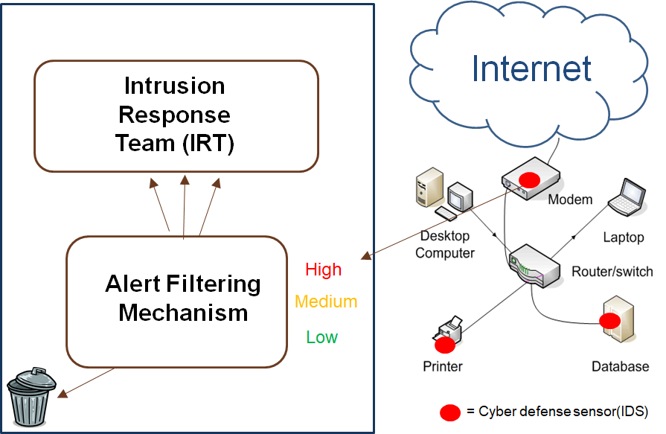
|
PROBLEM
STATEMENT
Notes:
So lets get a big picture of what this system typically looks like. On the right we have some private network connected to the internet. And on this network we have some intrusion detection software installed on the various network components. This IDS has sensors which generate alerts of varying severity when they detect anomalous behavior or maybe see a known malware signature. These alerts are sent to a kinda of alert filtering mechanism. And this mechanism decides which alerts to throw away and which alerts to pass on to the intrusion response team – who will actually investigate and try to remedy any intrusion if necessary. So our work focuses on

Slide 6
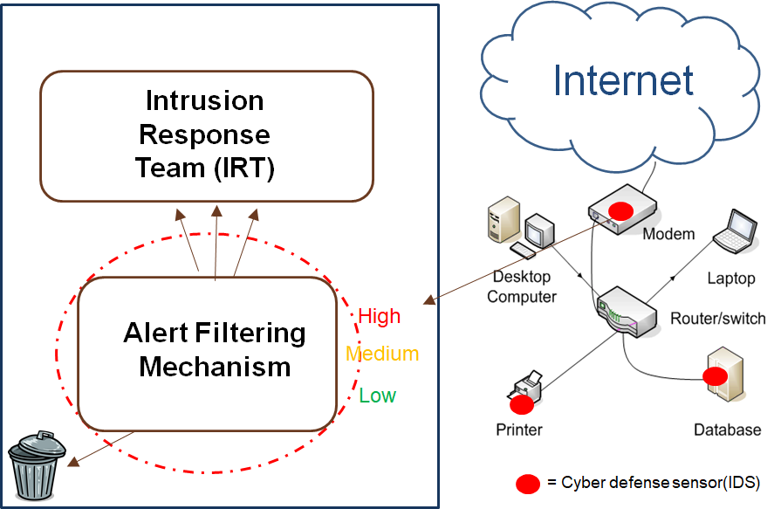
|
PROBLEM
STATEMENT
Notes:
This area here. That is, we want to come up with a good way to filter this crazy amount of alerts so as to maximize an organizations overall safety. And the way we propose to do this, is game theory.

Slide 7
|
RELATED
WORKS
Game Theory has been successful at solving similar problems in the past
TSA passenger screening [Brown, Sinha, Schlenker, & Tambe, 2016]
Fare inspection on public transit systems [Yin et al., 2012]
Previous cyber-alert screening models focused on single-shot games with no temporal aspect [Schlenker et al., 2017]
Other works focused on optimizing analyst availability [Ganesan, Jajodia, & Cam., 2016; Altner & Servi, 2016]
Notes:
And game theoretic approaches have been successful at solving similar problems in the past. Its been used to help the TSA screen passengers at airports and was used also used to come up with the best way to screen passengers on public transit systems to make sure they paid for their tickets. Now in either of these we can view these passengers kind of as the alerts, where most people are good citizens just trying to get to their destination (these are our false positives of course) but we do have a small number of bad actors who represent legitimate threats. Some work has also been done on specifically cyber alert screening, but it focused on a single-shot game that had no temporal aspect to it. That is, we end up with a static screening strategy that doesn’t change over time. And we’ve also seen some work that attempted to maximize our analyst availability and work scheduling.

Slide 8
|
CONTRIBUTIONS
We build on past research by employing game-theoretic models to derive screening strategies in a cyber domain
Instead of using single-shot games, our model uses a Markov game framework to introduce a temporal aspect of play
We use value iteration to learn optimal sub-game strategies which attempt to minimize defender risk in the long term
Notes:
So, similar to this past research we want to employ game-theoretic models to these threat screening games. But instead of using these single-shot games, our model uses a Markov game framework, which allows us to introduce a temporal aspect of play. To solve these Markov games we use value iteration, which is common in the reinforcement learning domain, and this allows us to learn optimal sub-game strategies that minimize our defenders risk in the long term.

Slide 9
|
OUTLINE
Motivation
Problem Statement
Related Works
Contributions
Markov Game Model
Game Theory 101
Value Iteration
Results
Conclusion
Notes:
Alrighty, so now that we’ve kinda motivated and described our problem lets dive into how we propose to solve this thing. And that solution starts with Markov games.

Slide 10
|
MARKOV GAME
MODEL
A 2-player Markov game is defined by the tuple: < S, A_{atk} , A_{def} , R, T, 𝛿 >
S is a finite set of states the environment can enter
A_{atk} & A_{def} are the set of actions available to each agent
R: S × A_{atk} × A_{def} ⟶ $ℝ$ is each agent’s reward function
T: S × A_{atk} × A_{def} ⟶ PD(S) is the transition function
$0≤δ<1$ is a discount factor used for learning
Notes:
So a 2 player markov game is defined by this tuple here. Where S is a finite set of states the environment can enter, with each state being a kind of snapshot of our system. A-one and A-two are the set of actions available to each player. We have a reward function R which describes the reward our players receive from a given action-pair in some state. And we have this T which describes how our system transitions between states given some action-pair. And lastly, this discount factor delta is used for learning and helps with convergence, but don’t worry too much about that guy. So if you’re familiar with Markov decision processes this tuple should look quite familiar, the main difference with Markov games is of course that in each of these states our agents play a game. But anyways, lets see what each of these components looks like in the context of our model.

Slide 11
|
MARKOV GAME
MODEL
The state s is defined by the tuple: < E, B, $θ>$
E the number of time-steps before each analyst becomes available (e.g. E = [3 1 0])
B describes the attacker’s current budget (e.g. B = 5)
$θ$ is the current batch of alert arrivals (e.g. $θ= )$
3
1
0
H
H
M
Notes:
First, a state s, for us, is defined by the tuple E, B, and theta. Now E is our defenders resource and it describes the current availability of our analysts with each number representing the amount of time needed before they’re ready for assignment. So for example you can see here we have three analysts, the first is going to be busy for 3 timesteps, the second only has one more to go, and our third is available right now. B Is our attackers risk budget. Its an integer value that represents the amount of risk they’re willing to undertake. This attempts to model the fact that most attackers seek to remain stealthy and wont, for example, generate a large volume of high alerts over a short period of time which would risk exposing them. If the attacker doesn’t attack in a state, the budget is incremented by one. Lastly this theta represents the current arrival batch that our agents are dealing with. Its important to note here that in our system the state is fully observable to both agents, meaning the attacker can see the current state of the analysts. This may seem like a strong assumption but remember, we’re optimizing our defense strategy against the strongest possible opponent – so we’re safe to assume they have full observability of the state.

Slide 12
|
MARKOV GAME
MODEL
Each alert level corresponds to a cost for either player
Based on B and $θ$ the attacker can choose some combination of alerts to attack in
Alert Type | High (H) | Medium (M) | Low (L)
Cost | 5 | 3 | 1
5
5
H
H
M
B = 10 ,
$θ$=
H
H
M
5
3
H
H
M
…
Notes:
So the actions available to each agent depend on the state of their resources. And these resources incur a cost when dealing with the various alert levels which is defined by this C. So here a high alert costs 5, a medium alert costs 3, and a low alert costs 1. Now based on E and thea, the defender can choose some combination of alerts to assign. So for, example, with two experts available the defender may choose to assign that medium and the second low. However, they wouldn’t be able to assign all three since one of the analysts is busy. Similarly, the attacker can choose any combination of alerts to attack in as long as the sum of their costs is less than or equal to the attackers current budget.

Slide 13
|
MARKOV GAME
MODEL
Based on E and $θ$ the defender can choose some combination of alerts to assign to free analysts
H
H
M
$θ$=
5
3
E =
,
H
H
M
3
0
0
H
H
M
5
5
…

Slide 14
|
MARKOV GAME
MODEL
The reward function R describes the utility awarded to the defender for detecting or missing true positives
H
H
M
Alert Type | Detection Reward | Undetected Penalty
High (H) | 100 | -100
Medium (M) | 20 | -20
Low (L) | 5 | -5
Attack Detected
False
Positive
Attack Undetected
100
+
0
+
-20
= 80
Notes:
The reward function R describes the utility awarded to the defender for detecting or missing true positives. This basically tells us what each alert level is worth to our players. So for instance, it might be 100 points for catching this high, 0 points for investigating this false positive, and -20 points for missing this medium. With the sum of all these outcomes constituting the reward for our defender.

Slide 15
|
MARKOV GAME
MODEL
Alert distribution Θ is the set of possible alert arrival batches
Each arrival batch $θ_{i}$ has some probability of arriving in a state
Once actions are taken a new alert arrival batch $θ$is sampled from $\text{Θ}$ and we transition to a new state
$$θ_{1}=$$
H
H
M
$$\sum_{i=1}^{|\text{Θ}|}{p(θ_{i})}=1$$
Θ =
$$θ_{2}=$$
H
M
M
L
$$θ_{3}=$$
M
L
L
$$…$$
Notes:
Now the uncertainty in our system is manifested in this alert batch distribution big-theta, which holds all the possible small-thetas that could arrive. Each of these small-thetas is assigned some probability of arriving, with the sum of all these probabilities being 1.

Slide 16
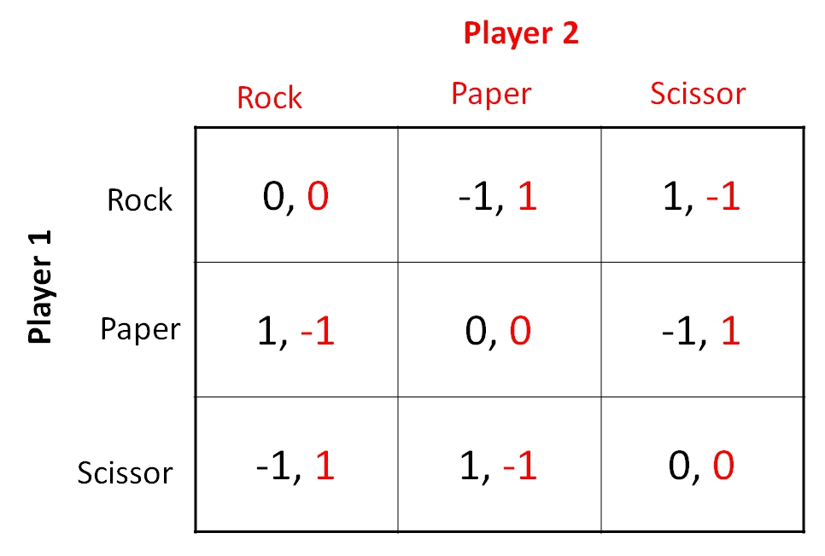
|
GAME THEORY 101
Rock-paper-scissors is an example of a zero-sum game
Optimal play occurs when the Nash equilibrium is reached
Informally, a Nash equilibrium occurs when neither player can benefit from changing their strategy
Solve games with linear programs
The solution to R-P-S is a mixed strategy of (1/3, 1/3, 1/3)
Game has expected value of 0
Notes:
So now lets do a quick refresher of game theory. First I’ll look at a game im sure youre all familiar with, which is rock-paper-scissors. The guy in the bottom right here is the payoff matrix for rock-paper-scissors. We have a row player in black, player 1, and a column player in red, which is player 2. Each row or column corresponds to a possible action for one of these players with the intersection of these actions being the utility awarded to each. So for example, iif player 1 chooses rock, and player 2 chooses paper, then player 1 gets -1 utility and player to gets 1 utility. Notice that the sum of both players rewards are always zero, which is why we refer to rock-paper-scissors as a zero-sum game. This basically means that a win for one player is symmetric in magnitude to the loss for the other player. So what we really want to know when it comes to games is, well, whats the best strategy to play? We find these strategies by finding a Nash equilibrium within the game. Informally, Nash occurs when neither player can benefit from changing their current strategy. We find Nash by translating this matrix into a system of linear equations that can be solved via linear programming. Typically when you solve one of these you get a mixed strategy for each player, which is basically a probability distribution over their possible actions, as well as the expected value of the game when these strategies are played. The LP solution for rock-paper-scissors tells us that we should play each action with an equal probability of (1/3) and will results in an expected value of 0. So lets see what a game looks like within our domain

Slide 17
|
GAME THEORY 101
s = <
, B = 7,
$θ$=
>
E =
0
0
H
M
Defender
H
M
H
M
H
M
H
M
H
M
-100, 100 | -100, 100 | 100, -100 | 100, -100
-20, 20 | 20, -20 | -20, 20 | 20, -20
0, 0 | 0, 0 | 0, 0 | 0, 0
Attacker
H
M
H
M
Notes:
So lets say we’re in this state s, where the defender has two analysts available for assignment, the attacker has a budget of 7, and a high and medium alert have just arrived. The defender in red can assign analysts to any combination of alerts b/c both analysts are available. However, the attacker must choose between either alert (or no alert at all) due to their budget being less than 8. We define the value of the state as the nash equilibrium value of this game

Slide 18
|
GAME THEORY 101
The LP seeks to maximize the defender utility knowing the attacker will attempt to minimize it:
s = <
, B = 7,
$θ$=
>
E =
0
0
H
M
H
M
H
M
H
M
H
M
H
M
-100, 100 | -100, 100 | 100, -100 | 100, -100
-20, 20 | 20, -20 | -20, 20 | 20, -20
0, 0 | 0, 0 | 0, 0 | 0, 0
H
M
H
M
Notes:
And this is the equation that describes how we find it: the defender maximizes their utility only after the attacker has minimized it. So ok, each game has a value, but to see how we use this value we first need to understand why this matrix in its current form is incomplete for our purposes.

Slide 19
|
VALUE ITERATION
This payoff matrix is incomplete!
Need to consider future state values
s = <
, B = 7,
$θ$=
>
E =
0
0
H
M
H
M
H
M
H
M
H
M
H
M
-100, 100 | -100, 100 | 100, -100 | 100, -100
-20, 20 | 20, -20 | -20, 20 | 20, -20
0, 0 | 0, 0 | 0, 0 | 0, 0
H
M
H
M
Notes:
Each action-pairs value only includes the immediate reward received by either agent. But since we’re in a Markov game, where a state is maintained between each game we play, we need to consider the future states actions will lead to. To illustrate this point, lets look at the outcome of this action pair here

Slide 20
|
VALUE ITERATION
s = <
, B = 7,
$θ$=
>
E =
0
0
H
M
H
M
H
M
H
M
H
M
H
M
-100, 100 | -100, 100 | 100, -100 | 100, -100
-20, 20 | 20, -20 | -20, 20 | 20, -20
0, 0 | 0, 0 | 0, 0 | 0, 0
H
M
H
M
Notes:
So the defender decides the safest thing to do in state s is to assign both alerts, which makes sense, right. And maybe the attacker decides they’ll go ahead and attack with a medium alert. Our defender detects the medium and gets a reward of 20, and now we transition to a new state s’

Slide 21
|
VALUE ITERATION
s’ = <
, B = 4,
$θ$=
>
E =
5
3
M
L
M
L
M
L
25, -25
20, -20
5, -5
0, 0
M
L
s = <
, B = 7,
$θ$=
>
M
L
E =
0
0
H
M
H
M
H
M
H
M
H
M
M
L
H
M
-100, 100 | -100, 100 | 100, -100 | 100, -100
-20, 20 | 20, -20 | -20, 20 | 20, -20
0, 0 | 0, 0 | 0, 0 | 0, 0
H
M
H
M
Notes:
Where a new alert arrival containing a medium and a low have arrived, and both experts are now busy. Our attacker however still has a budget of 4, meaning they can now choose any combination of alerts to attack in. But since our defender’s analysts are busy with the last states alerts, their only option is to do nothing. And since our attacker is maximizing their own utility, we know they’ll choose the worst thing for the defender, which is this

Slide 22
|
VALUE ITERATION
s’ = <
, B = 4,
$θ$=
>
E =
5
3
M
L
M
L
M
L
25, -25
20, -20
5, -5
0, 0
M
L
s = <
, B = 7,
$θ$=
>
M
L
E =
0
0
H
M
H
M
H
M
H
M
H
M
M
L
H
M
-100, 100 | -100, 100 | 100, -100 | 100, -100
-20, 20 | 20, -20 | -20, 20 | 20, -20
0, 0 | 0, 0 | 0, 0 | 0, 0
H
M
H
M
Notes:
So even though we received a value of 20 in s, the over-allocation of our analysts means we’re vulnerable in s’, leading to a value of -25. So what we want is a way to incorporate future state’s values into a current state’s payoff-matrix. And the way we do this is using a Q-function or quality function

Slide 23
|
VALUE ITERATION
$$Q\left(s,a,d\right)=M_{s}\left(a,d\right)+ δ\sum_{s′εS}{T(s,a,d,s^{′})V(s^{′})}$$
s’ = <
, B = 4,
$θ$=
>
E =
5
3
M
L
M
L
M
L
25, -25
20, -20
5, -5
0, 0
M
L
s = <
, B = 7,
$θ$=
>
M
L
E =
0
0
H
M
H
M
H
M
H
M
H
M
M
L
H
M
-100, 100 | -100, 100 | 100, -100 | 100, -100
-20, 20 | 20, -20 | -20, 20 | 20, -20
0, 0 | 0, 0 | 0, 0 | 0, 0
H
M
H
M
Notes:
Q, s, a, d. This function uses two terms, the first

Slide 24
|
VALUE ITERATION
$$Q\left(s,a,d\right)=M_{s}\left(a,d\right)+ δ\sum_{s′εS}{T(s,a,d,s^{′})V(s^{′})}$$
s’ = <
, B = 4,
$θ$=
>
E =
5
3
M
L
M
L
Immediate Reward
M
L
25, -25
20, -20
5, -5
0, 0
M
L
s = <
, B = 7,
$θ$=
>
M
L
E =
0
0
H
M
H
M
H
M
H
M
H
M
M
L
H
M
-100, 100 | -100, 100 | 100, -100 | 100, -100
-20, 20 | 20, -20 | -20, 20 | 20, -20
0, 0 | 0, 0 | 0, 0 | 0, 0
H
M
H
M
Notes:
Term represents the immediate reward that occurs under actions a and d in state s. The second term

Slide 25
|
VALUE ITERATION
$$Q\left(s,a,d\right)=M_{s}\left(a,d\right)+ δ\sum_{s′εS}{T(s,a,d,s^{′})V(s^{′})}$$
s’ = <
, B = 4,
$θ$=
>
E =
5
3
M
L
M
L
Immediate Reward
Expected Future Reward
M
L
25, -25
20, -20
5, -5
0, 0
M
L
s = <
, B = 7,
$θ$=
>
M
L
E =
0
0
H
M
H
M
H
M
H
M
H
M
M
L
H
M
-100, 100 | -100, 100 | 100, -100 | 100, -100
-20, 20 | 20, -20 | -20, 20 | 20, -20
0, 0 | 0, 0 | 0, 0 | 0, 0
H
M
H
M
Notes:
Seeks to incorporate the expected value of playing games in future states. So once we’ve replaced all immediate reward values in a payoff-matrix with these Q-values, we can solve our LP and get a mixed strategy that considers the future and not just immediate rewards.

Slide 26
|
VALUE ITERATION
For each state s, initialize
For $i=1$ until convergence { For each state s: For all a,d in $M_{s}$: $i=i+1$ }
Notes:
So here’s a quick snap-shot of the pseudo-code for the Markov game value iteration. First we solve every state’s payoff matrix with only the immediate rewards, and store those values in V-zero. Then in our second step we start iterating over these values. In each iteration we go to every state and re-populate its payoff matrix with the Q-values we talked about. Once the payoff matrix of a state has been filled with these Q-values we then solve it with our LP to obtain a new V. Once that’s done for all states we iterate this i variable and go again. And of course this process continues until these V-values converge.

Slide 27
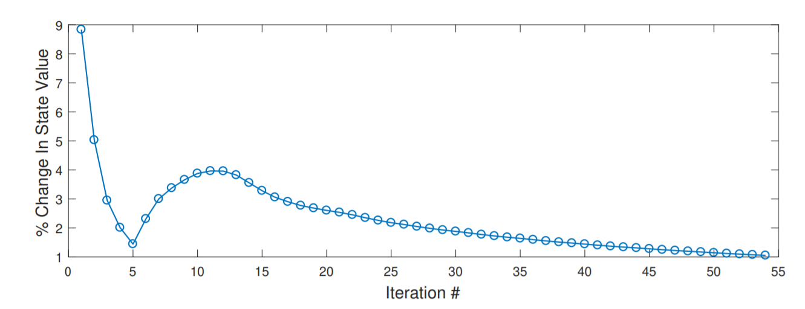
|
VALUE ITERATION
Guaranteed to converge [M. Littman, 2000]
Notes:
Theres a paper in my references by Littman that will provide it. So what we’re looking at here is a plot of our value-functions convergence for one of our experiments. So on the x-axis we have the number of iterations, and the y-axis is the %-change in value between each iteration. As you can see, given some time the agents learn that their resources can regenerate around the 5 and 6 iterations and this causes a spike that kinda dies off around iteration 55

Slide 28
|
OUTLINE
Motivation
Problem Statement
Related Works
Contributions
Markov Game Model
Game Theory 101
Value Iteration
Results
Conclusion
Notes:
So ok, now that we know what these Markov game models look like, and how we solve them, lets see some results

Slide 29
|
RESULTS
We have four policies during our simulations
Random – Choose a random action in each state
Greedy – Prioritize highest alerts levels first
Linear Programming – Run LP over immediate rewards in each state
Value Iteration - Our approach (Linear programming + value iteration)
We run 500 simulations lasting 100 rounds for all 16 combinations of attacker-defender policies and average the step-wise cumulative utility for each
Notes:
So to test our approach we developed a few heuristics for both agents that we can use to test against. We have a random strategy which is kind of our control as it just samples randomly from the action space in every state. We have the greedy heuristic, which causes our agent to always prioritize either high-attacks or high-assignments for the attacker and defender respectively. We have a Myopic approach, which is using LP’s in every state without employing the value iteration. And of course our value iteration approach. So we ran 500 simulations lasting 100 rounds for all 16 combinations of the attacker-defender strategies and averaged their step-wise cumulative utility. And the plot for these simulations looks like this

Slide 30
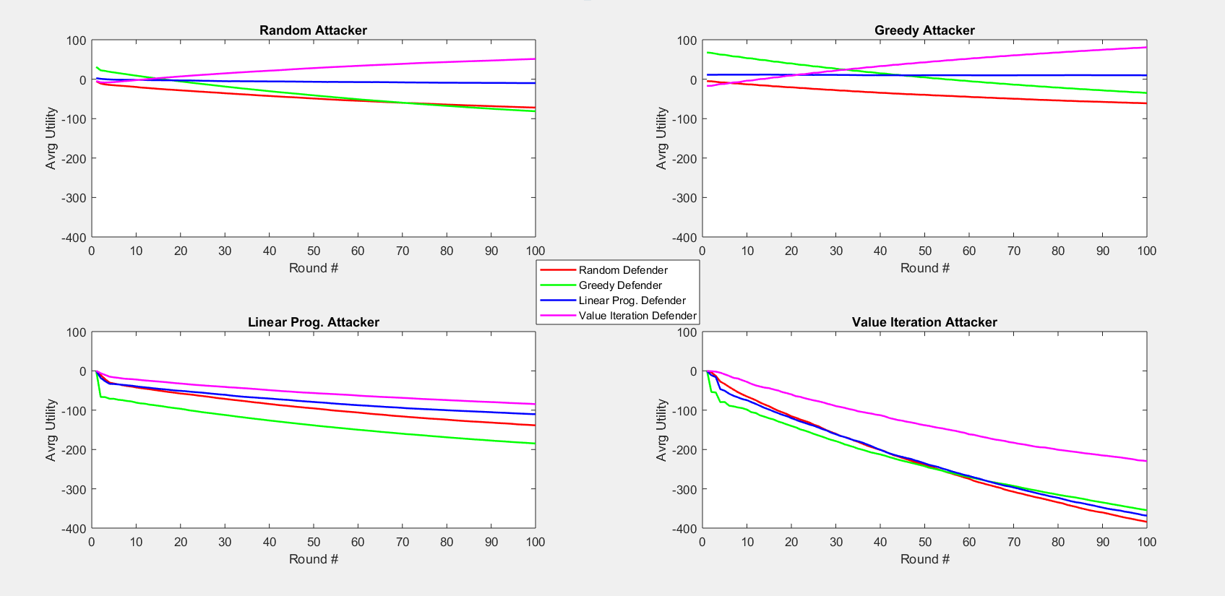
|
RESULTS
Notes:
So each plot represents a different attacker strategy, so we have a random attacker in the top left, then greedy attacker in the top right, the myopic LP attacker in the bottom left, and the value iteration attacker in the bottom right. Each plot has an x-axis representing the number of transitions the system has made and a y-axis which is the cumulative utility up until that point. Each line in one of these plots is one of the defender strategies. So we can clearly see that our approach outperforms all others. Especially against our worst-case VI attacker. Its interesting to note that against the random and greedy attackers the VI defender starts out pretty bad, but since the greedy defender always over-allocates and doesn’t effectively manage their resources, they fall behind after about 30 or so steps. This is because our VI approach is looking far into the future and assigns analysts accordingly. And its interesting to note that even though the VI algorithm was trained against a worst-case opponent it still performs well when the attacker doesn’t behave rationally. And this is a by-product of playing that sub-game Nash equilibrium, because remember, Nash means that no player can benefit by changing their strategy, which is exactly what an irrational attacker is doing.

Slide 31
|
CONCLUSION
Our approach clearly outperforms the other policies in terms of cumulative utility
It values a wide range of coverage and effectively uses its resources to ensure analysts are always available for assignment
Even though we assume the worst-case opponent, the algorithm maintains the highest utility across all attacker policies
Worst-case optimality seems especially useful in the security domain where it’s good practice to operate under the expectation of the worst-case scenario
Notes:
So in conclusion. Our approach clearly outperformed the other policies. And when we took a closer look at its behavior it was clear that it had found a good balance between investigating a low number of high severity alerts and a high number of lower severity alerts. And it did this by balancing out its alert assignments so analysts were always available. And even though we assumed the worst-case opponent during training, it still maintained the highest utility when faced with new attacker policies. And this really exemplifies the usefulness of the worst-case thinking present in game-theoretic approaches and supports the idea that your should always prepare for the worst-case scenario and assume you’re up against highly intelligent and rational attackers.

Slide 32
|
CONCLUSION
Now that we know game theory provides potent defense strategies we want to expand our model and work with much larger state spaces
Large state spaces cause value iteration to become intractable
Experimenting with approximation techniques like deep reinforcement learning
Notes:
So our current work is focusing on approximating this sub-game Nash b/c as the state space grows VI quickly becomes intractable. We’re experimenting with different deep-reinforcement-learning approaches and hope to end up with an even more realistic model with more analysts, alerts, and actions.

Slide 33
THANK YOU
Notes:
So lastly I’d like to acknowledge all of our sponsors who made this work possible. As well as the reviewers and organizers here at NCS. Thank your for your time and attention.

Slide 34
[1] “Hiscox Cyber Readiness Report 2017.” The Hiscox Cyber Readiness Report, 2017
[2] “The Cost of Malware Containment” Ponemon Institute (2015)
[3] M. Brown, A. Sinha, A. Schlenker, and M. Tambe. “One Size Does Not Fit All: A Game-Theoretic Approach for Dynamically and Effectively Screening for Threats.” AAAI conference on Artificial Intelligence, 2016
[4] Z. Yin, A. Jiang, M. Tambe, C. Kiekintveld, K. Leyton-Brown, T. Sandholm, J. Sullivan. “Trusts: Scheduling randomized patrols for fare inspection in transit systems using game theory”. In Proceedings of the 24th IAAI
[5] A. Schlenker, H. Xu, M. Guirguis, M. Tambe, A. Sinha, C. Kiekintveld, S. Sonya, N. Dunstatter, D. Balderas. “Towards a game-theoretic framework for intelligent cyber-security alert allocation” IJCAI, 2017
[6] D. Altner and L. Servi. “A two-stage stochastic shift scheduling model for cybersecurity workforce optimization with on call options” (2016)
[7] R. Ganesan, S. Jajodia, H. Cam. “Optimal Scheduling of Cybersecurity Analysts for Minimizing Risk Using Reinforcement Learning” ACM, 2016
[8] M. Littman. “Value-function reinforcement learning in Markov games” Princeton University Press, 2000
Notes:
Title slide with special thanks to DHS and NSF (work sponsered by)

